Slide 1


Melissa Vales
11/26/2024

Slide 2

Outline
Executive Summary
Introduction
Methodology
Results
Conclusion
Appendix

Slide 3
Executive Summary
Summary of methodologies
Data Collection through API
Data Collection with Web Scrapping
Data Wrangling
Exploratory Data Analysis with SQL
Exploratory Data Analysis with Data Visualization
Interactive Visual Analytics with Folium
Machine Learning Prediction
Summary of all results
Exploratory Data Analysis with Visualization Results
Exploratory Data Analysis with SQL Results
Interactive Map with Folium Results
Plotly Dash Dashboard Results
Predictive Analysis (Classification) Results

Slide 4
Introduction
Project background and context
In this capstone, a machine learning pipeline was used to predict if the Falcon 9 first stage will land successfully. SpaceX advertises Falcon 9 rocket launches on its website, with a cost of 62 million dollars; other providers cost upward of 165 million dollars each, much of the savings is because SpaceX can reuse the first stage.
Problems you want to find answers
Therefore, if we can determine if the first stage will land, we can determine the cost of a launch. This information can be used if an alternate company wants to bid against SpaceX for a rocket launch.

Slide 5

Section 1

Slide 6
Methodology
Executive Summary
Data collection methodology:
SpaceX launch data was gathered from an API, specifically the SpaceX REST API
Data was also obtained from Wikipedia via Web Scrapping
Perform data wrangling
Space X Falcon 9 First Stage Landing Outcomes (Success or Failure) were converted into Training Labels (1or 0)
1 = booster landed successfully, 0 = booster was unsuccessful
Perform exploratory data analysis (EDA) using visualization and SQL
Perform interactive visual analytics using Folium and Plotly Dash
Perform predictive analysis using classification models
This includes preprocessing, standardizing data, using Train_test_split and performing a grid search that will find the hyperparameters that will show which algorithm will perform best. This can be done by Logistic Regression, Support Vector machines, Decision Tree Classifier, K-nearest neighbors and a confusion matrix.

Slide 7
Data Collection
Data was collected via SpaceX API and web scrapped from Wikipedia
SpaceX API
Web Scrapping
Import Libraries (i.e., requests, pandas, numpy datatime etc.)
Request rocket launch data from SpaceX REST API
Request and parse the SpaceX launch data using the GET request
Filter the dataframe (i.e., Falcon 9 launches)
Data Wrangling
Import packages (i.e., requests, bs4, pandas etc.)
Request the Falcon9 Launch Wiki page from its URL (HTTP GET method)
Extract all column/variable names from the HTML table header
Create a data frame by parsing the launch HTML tables
Import Libraries (i.e., requests, pandas, numpy datatime)
Data Wrangling

Slide 8
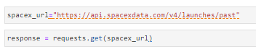
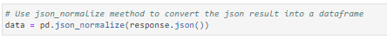
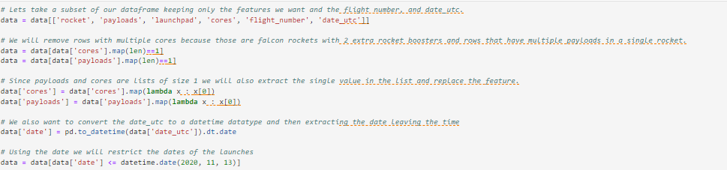
Data Collection – SpaceX API
Data collection with SpaceX REST calls
Link here: GitHub URL
1. Request rocket launch data from SpaceX API using a URL
2. Use the static response object to make the requested JSON results more consistent
3. Decode the response content as a Json and turn it into a Pandas dataframe
4. Use API to get information about the launches using the IDs given for each launch

Slide 9
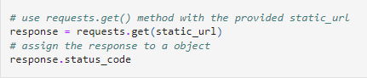
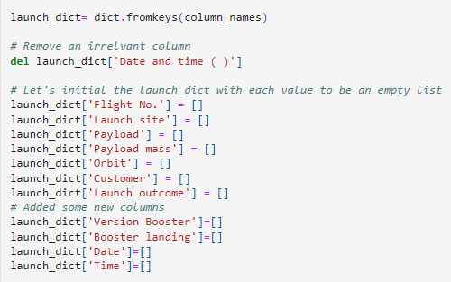
Data Collection - Scraping
Web scraping process
Link here: GitHub URL
1. Perform an HTTP GET method to request the Falcon9 Launch HTML pages, as an HTTP response
2. Create a BeautifulSoup object from HTML response
3. Create an empty dictionary with keys from the extracted column names

Slide 10
Data Wrangling
Exploratory Data Analysis (EDA) was used to find patterns in the data and to determine the label for training supervised models. Outcomes were converted to Training Labels with 1 (successfully landed) and 0 (Unsuccessful landing).
Link here: GitHub URL
Import libraries (i.e., pandas, numpy etc.)
Load Space X dataset
Calculate the number of launches on each site – use method value_counts()
Calculate the number and occurrence of each orbit- use method value_counts()
Calculate the number of occurrence of mission outcome of orbits – use method value_counts()
Create a landing outcome label from Outcome column (1 or 0)

Slide 11
EDA with Data Visualization
Summary of chart that were plotted:
FlightNumber vs Payload
As flight number increases, the first stage is more likely to land successfully. With more massive payloads, the first stage returns successfully. Catplot was used to visualize this relationship
Flight Number vs Launch Site
Catplot was used to visualize the relationship between Flight Number and Launch Site. Some launch sites were more successful than others as flight numbers increased.
Payload Mass vs Launch Site
A Catplot was used to visualize the relationship between payload mass and launch site. There were no rockets launched for heavypayload mass for launch site VAFB-SLC
Relationship between success rate of each orbit type
A bar chart was used to visualize the relationship between success rate of each orbit type. Orbit types SSO, HEO, GEO and ES-L1 had the highest success rate.

Slide 12
EDA with Data Visualization Cont.
Relationship between FlightNumber and Orbit type
A Catplot was used to visualize the relationship between flight number and Orbit type. In the LEO orbit, success is related to the number of flights. For the GTO orbit, there is no relationship between flight numbers and success.
Relationship between Payload Mass and Orbit type
A Catplot was used to visualize the relationship between payload mass and orbit type. For orbit types Polar, LEO and ISS, the heavy payloads had more successful landings
Launch success yearly trend
A line chart was used to visualize the launch success yearly trend. The success rate increased from 2013 to 2020.
Link Here: GitHub URL

Slide 13
EDA with SQL
SQL queries performed:
1. Display the names of the unique launch sites in the space mission
%sql SELECT DISTINCT LAUNCH_SITE FROM SPACEXTBL
2. Display 5 records where launch sites begin with the string ‘CCA’
%sql SELECT * FROM SPACEXTBL WHERE LAUNCH_SITE LIKE ‘CCA%’ LIMIT 5
3. Display the total payload mass carried by boosters launched by NASA (CRS)
%sql SELECT SUM(PAYLOAD_MASS_KG_) FROM SPACEXTBL WHERE CUSTOMER = ‘NASA(CRS)’
4. Display average payload mass carried by booster version F9 v1.1
%sql SELECT AVE(PAYLOAD_MASS_KG_) FROM SPACEXTBL WHERE BOOSTER_VERSION = ‘F9 v1.1’

Slide 14
EDA with SQL
5. List the date when the first successful landing outcome in ground pad was achieved
%sql SELECT MIN(DATE) FROM SPACEXTBL WHERE LANDING_OUTCOME = ‘SUCCESS (GROUND PAD)’
6. List the names of the boosters which have success in drone ship and have payload mass greater than 4000 but less than 6000
%sql SELECT BOOSTER_VERSION FROM SPACEXTBL WHERE LANDING_OUTCOME = ‘SUCCESS (DRONE SHIP)’ AND PAYLOAD_MASS__KG_ > 4000 AND PAYLOAD_MASS__KG_ < 6000
7. List the total number of successful and failure mission outcomes
%sql SELECT COUNT(MISSION_OUTCOME) FROM SPACEXTBL WHERE MISSION_OUTCOME = ‘SUCCESS’ OR MISSION_OUTCOME = ‘FAILURE (IN FLIGHT)’
8. List the names of the booster_versions which have carried the maximum payload mass.
%sql SELECT BOOSTER_VERSION FROM SPACEXTBL WHERE PAYLOAD_MASS__KG_ = (SELECT MAX(PAYLOAD_MASS__KG_) FROM SPACEXTBL)

Slide 15
EDA with SQL
9. List the record which will display the month names, failure landing_outcomes in drone ship, booster versions, launch_site for the months in year 2015
%sql SELECT MISSION_OUTCOME, BOOSTER_VERSION, LAUNCH_SITE FROM SPACEXTBL WHERE EXTRACT (YEAR FROM DATE) = ‘2015’ AND LANDING_OUTCOME LIKE ‘%FAILURE%’
10. Rank the count of landing outcomes (such as Failure (drone ship) or Success (ground pad)) between the date 2010-06-04 and 2017-03-20, in descending order.
%sql SELECT LANDING_OUTCOME, COUNT(*) AS COUNT_LANDING_OUTCOME FROM SPACEXTABLE WHERE (DATE BETWEEN ‘2010-06-04’ AND ‘2017-03-20’) GROUP BY LANDING_OUTCOME ORDER BY COUNT_LANDING_OUTCOME DESC
Link Here: GitHub URL

Slide 16
Build an Interactive Map with Folium
Summary of map objects such as markers, circles, lines created and added to a folium map
folium.Circle and folium.Marker
Used to add a highlighted circle area with a text label on a specific coordinate
MarkerCluster
Helps combine markers of close proximity into clusters. This will simplify the display of markers on the map.
MousePosition
This will get a coordinate for a mouse over a point on the map
Folium.PolyLine
This will draw a line between launch sites to the selected coastline point
Link Here: GitHub URL

Slide 17
Build a Dashboard with Plotly Dash
Summary of plots/graphs and interactions added to the dashboard
Launch Site Drop-down Input Component
Will allow selection of different launch sites
callback function 1
Will render success-pie-chart based on selected site dropdown
Range slider
Will Select Payload
callback function 2
Will render success-payload-scatter-chart scatter plot
Link here: GitHub URL

Slide 18
Predictive Analysis (Classification)
Summary of how the model was built, evaluated, improved, and best performing classification model
Link here: GitHub URL
Import libraries (i.e., pandas, numpy etc.)
Load the dataframe
Create NumPy array (assign to variable Y) and standardize the data in X
Use the function train_test_split to split data X and Y into training and test data
Create logistic regression and GridSearchCV object
Calculate the accuracy on the test data using the method score
Find the method that performs best
Calculate the accuracy of knn_cv on the test data using the method score
Create a k nearest neighbors object and then create a GridSearchCV object knn_cv
Calculate the accuracy of tree_cv on the test data using the method score
Create a decision tree classifier object and create a GridSearchCV object
Calculate the accuracy on the test data using the method score
Create a support vector machine object and create a GridSearchCV object

Slide 19
Results
Exploratory data analysis results
Interactive analytics demo in screenshots
Predictive analysis results

Slide 20

Section 2

Slide 21
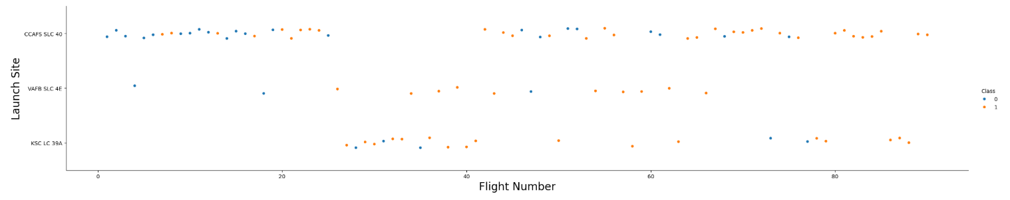
Flight Number vs. Launch Site
As the Flight Number increases there are more successful landings at each of the Launch Sites.
CCAFS SLC 40 had the most successful landings as the Flight Number increased

Slide 22
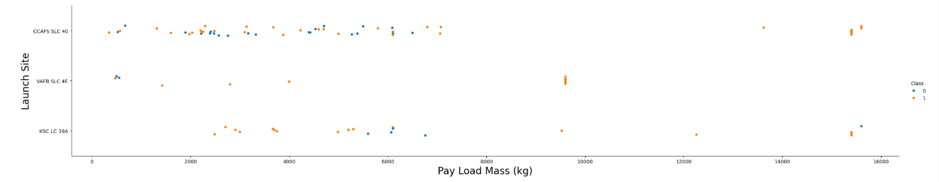
Payload vs. Launch Site
VAFB-SLC launch site has no rockets launched for heavypayload mass(greater than 10000).
CCAFS SLC 40 and KSC LC 39A had successful landings when Pay Load Mass was greater then 14000 kg.

Slide 23
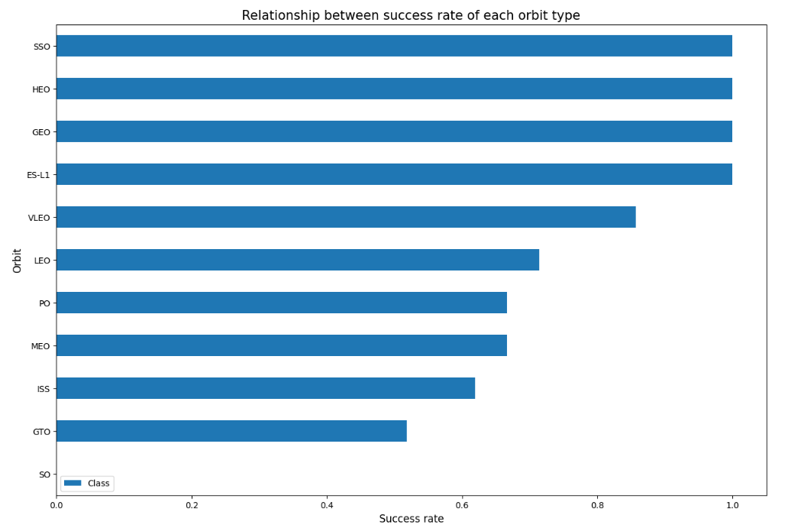
Success Rate vs. Orbit Type
Orbit types: SSO, HEO, GEO, and ES-L1 has the greatest success rate.
Orbit type: SO had no success rate.

Slide 24
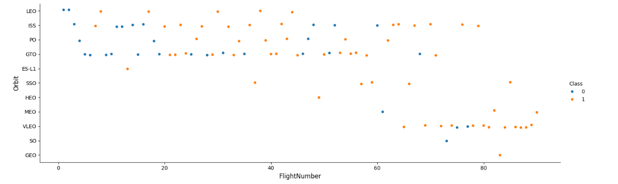
Flight Number vs. Orbit Type
In the LEO orbit, success is related to the number of flights.
In the GTO orbit, there is no relationship between flight number and success.

Slide 25
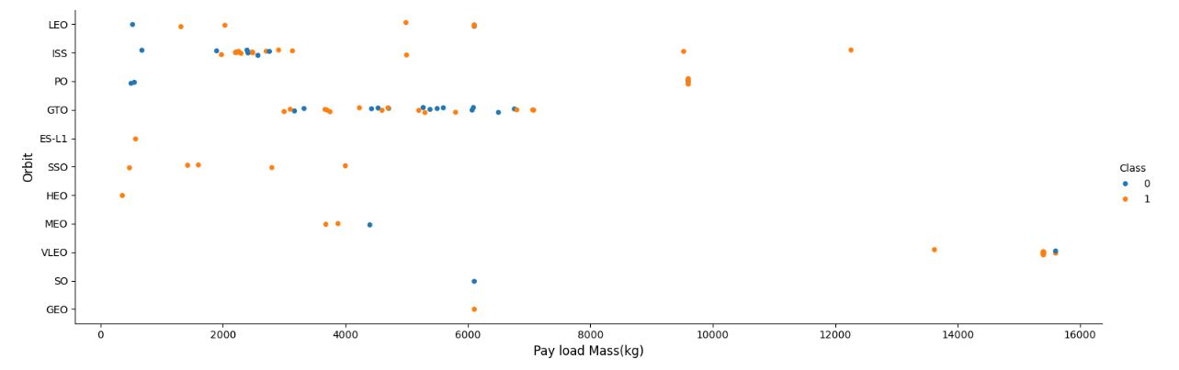
Payload vs. Orbit Type
Orbit types: Polar, LEO, and ISS had more successful landings with heavy payloads
GTO had both successful and unsuccessful landings, therefore a relationship between payload and orbit type is not easy to discern.

Slide 26
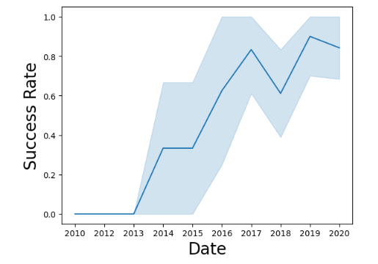
Launch Success Yearly Trend
The success rate increased from 2013-2020.

Slide 27
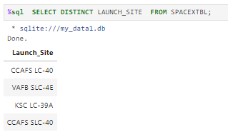
All Launch Site Names
There are four unique launch sites: CCAFS LC-40, VAFB SLC-4E, KSC LC-39A, CCAFS SLC-40
A “Distinct” statement was used to obtain these four launch sites.

Slide 28
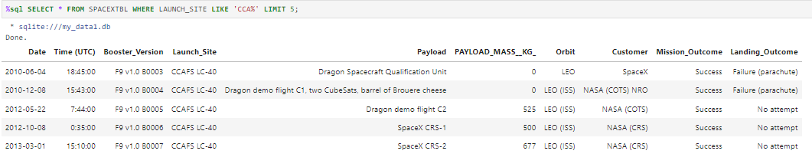
Launch Site Names Begin with 'CCA'
There are 5 records where launch sites begin with `CCA`
“Like” was used to check for “CCA” and “Limit” was used to obtain only 5 records.

Slide 29
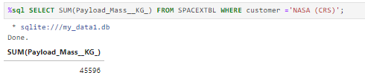
Total Payload Mass
The total payload carried by boosters from NASA was 45,596 KG

Slide 30
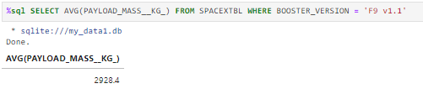
Average Payload Mass by F9 v1.1
The average payload mass carried by booster version F9 v1.1was 2,928.4 KG

Slide 31
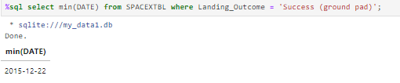
First Successful Ground Landing Date
The dates of the first successful landing outcome on ground pad was 2015-12-22

Slide 32
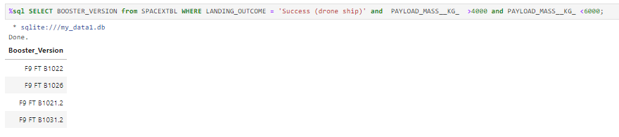
Successful Drone Ship Landing with Payload between 4000 and 6000
The following boosters have successfully landed on drone ship and had payload mass greater than 4000 but less than 6000 : F9 FT B1022, F9 FT B1026, F9 FT B1021.2, F9 FT B1031.2

Slide 33
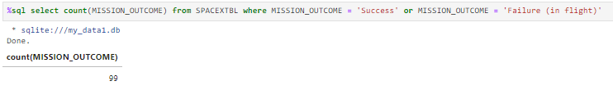
Total Number of Successful and Failure Mission Outcomes
The total number of successful and failure mission outcomes was 99

Slide 34
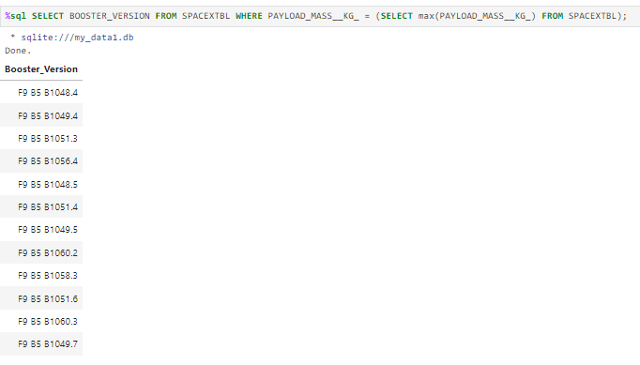
Boosters Carried Maximum Payload
The above SQL output lists the names of the booster which have carried the maximum payload mass

Slide 35
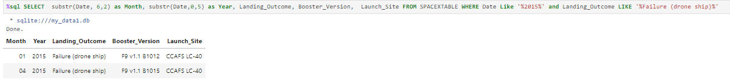
2015 Launch Records
The above SQL graph lists the failed landing_outcomes in drone ship, their booster versions, and launch site names for in year 2015

Slide 36
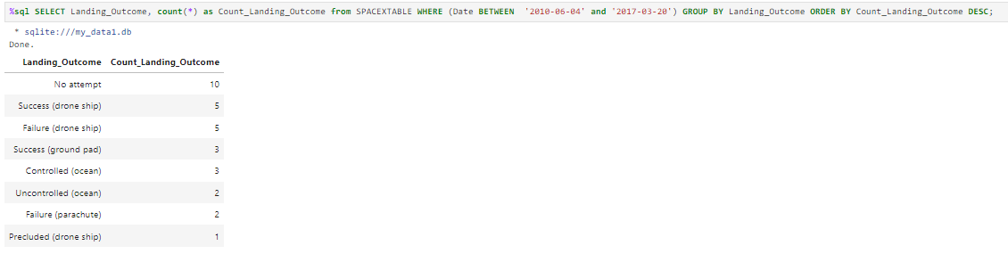
Rank Landing Outcomes Between 2010-06-04 and 2017-03-20
The above SQL graph shows the count of landing outcomes (such as Failure (drone ship) or Success (ground pad)) between the date 2010-06-04 and 2017-03-20, in descending order

Slide 37

Section 3

Slide 38
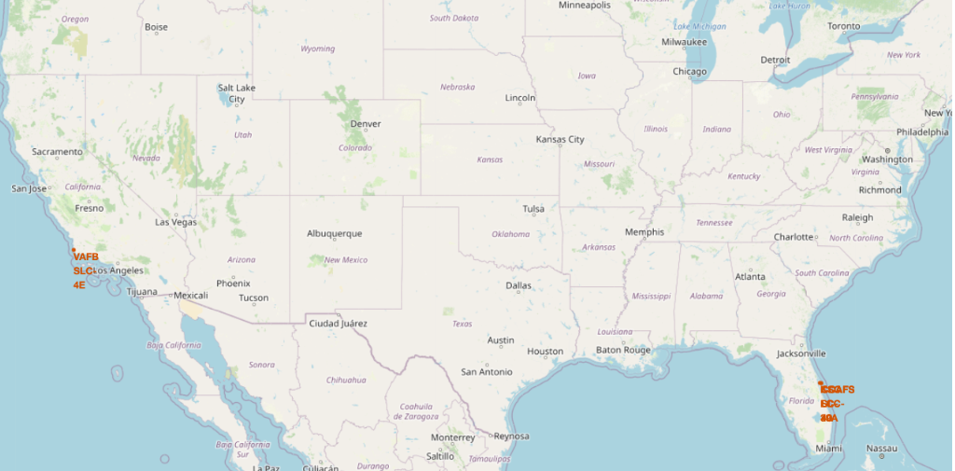
All Launch Sites
Launch sites are located on both the east and west coast. This is zoomed out area, however, Florida has 3 launch sites (not shown).

Slide 39
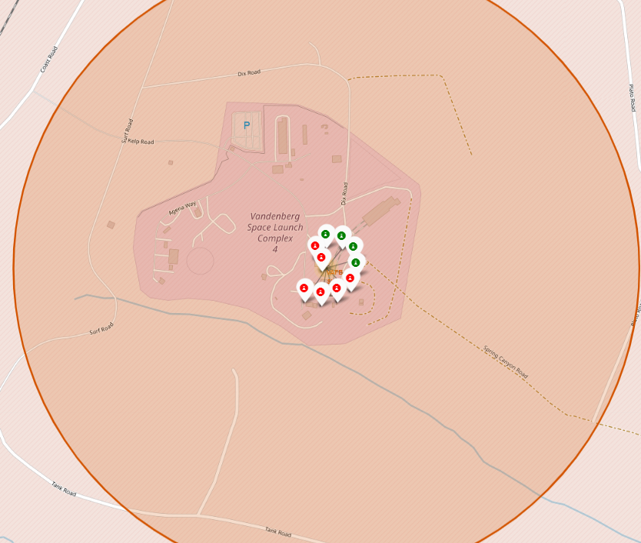
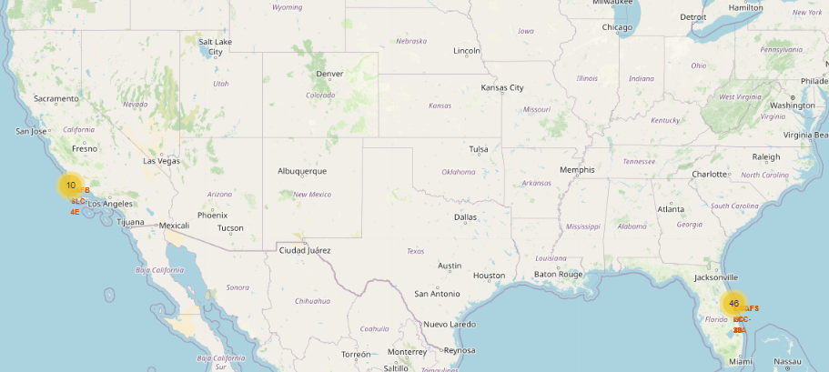
Successful and Failed Launches per Site
Zoom in – Map on left
The Vandenberg Space Launch Complete 4 had 6 failures (red) and 4 successes (green)
Zoom Out – Map on Right
Shows high-level of sites: 10 (west coast) and 46 (east coast) success/failure launches.

Slide 40
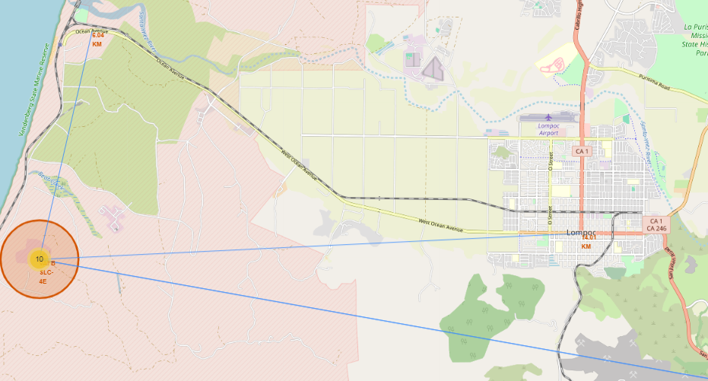
Launch Site to its proximities (Railway, Highway, Coastline)
Looking at the VAFB SLC- 4E, it can be shown that this is near major highways in multiple directions of the launch site.

Slide 41

Section 4

Slide 42
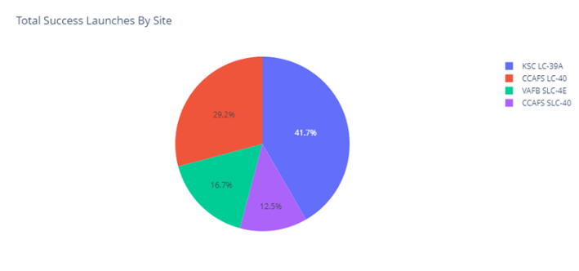
Total Success Launches By All Sites
KSC LC-39A had the greatest success at 41.7% while CCAFS SLC-40 had the lowest successful launch at 12.5%

Slide 43
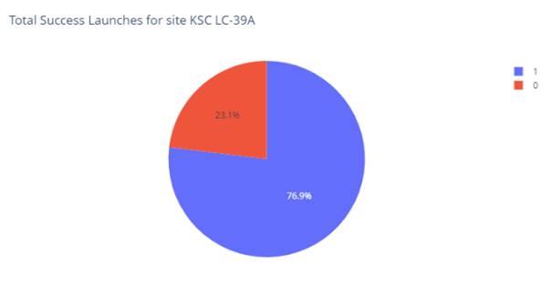
Total Success Launches for Site KSC LC-39A
There was a 76.9% success rate for KSC LC-39A

Slide 44
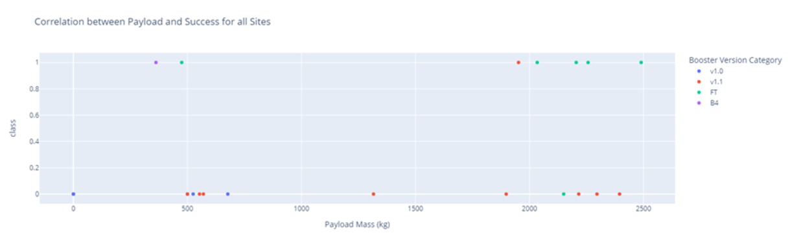
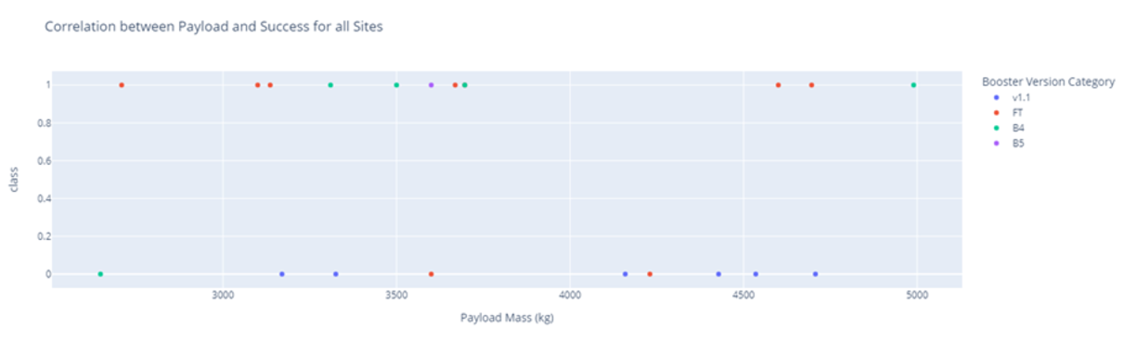
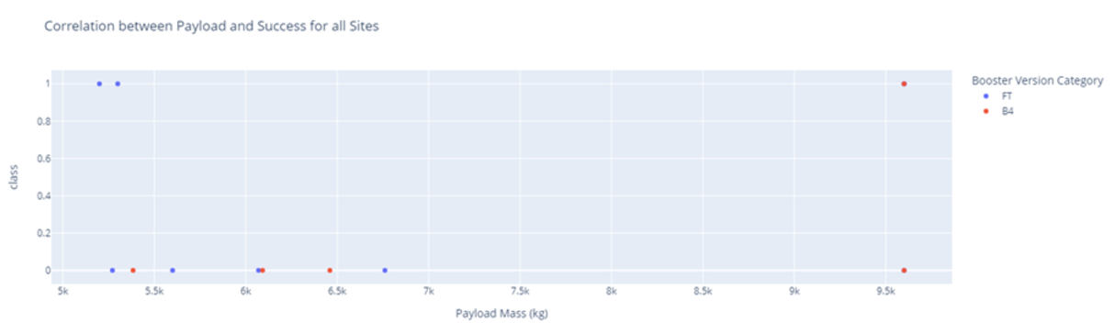
Payload vs. Launch Outcome scatter plot for all sites
Low weighted payloads have a higher success rate then high weighted payloads. The top left graph depicts this with payloads between 0 – 2500 kg

Slide 45

Section 5

Slide 46
Classification Accuracy
All models performed at the same accuracy of 83.33%

Slide 47
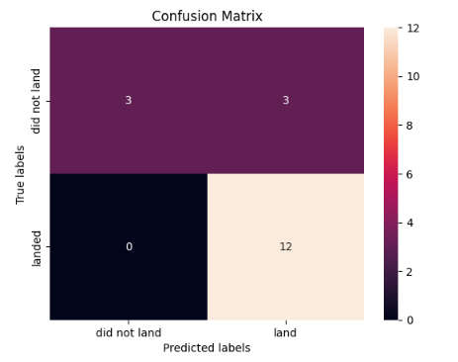
Confusion Matrix
All models (4) performed very similar. Most of the models had high false positives. These represent unsuccessful landings that are incorrectly marked as successful landing.

Slide 48
Conclusions
As the Flight Number increases there are more successful landings at each of the Launch Sites
The success rate increased from 2013-2020
Orbit types: Polar, LEO, and ISS had more successful landings with heavy payloads
Orbits ES-L1, GEO, HEO, SSO, and VLEO had the highest success rate
There was a 76.9% success rate for KSC LC-39A
All models (4) performed very similar. Most of the models had high false positives.

Slide 49
Appendix
Notebooks and scripts can be found in the GitHub repository

Slide 50


